Slide 1
Error Handling

Slide 2
What is Error Handling ?
Error Handling means it stops the execution of the flow and logs the information about the errors. Mule default error handler acts the same for all the applications and cannot be configured manually, when an error is thrown, an error object is created and added to the mule event.
Errors that occur in Mule belong to one of two major categories :
System Errors
Messaging Errors

Slide 3
What is System Errors ?
Mule throws a system error when an exception occurs at the system level and no Mule event is involved. A system error handler manages exceptions that occur:
During application startup.
When a connection to an external system fails.
When a system error occurs, Mule sends an error notification to registered listeners, logs the error, and if the error is caused by a connection failure, executes a reconnection strategy.
System error handlers are not configurable in Mule.

Slide 4
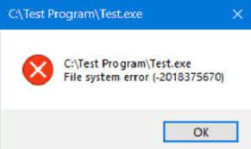

Slide 5
What is Message Errors ?
Mule throws a messaging error (a Mule error) whenever a problem occurs within a flow of a Mule app, where Mule events and the messages they contain are processed.
You can handle Mule messaging errors in more than one way:
1. Error handling mechanism
2. On error continue
3. On error propagate
4. Try Catch scope

Slide 6
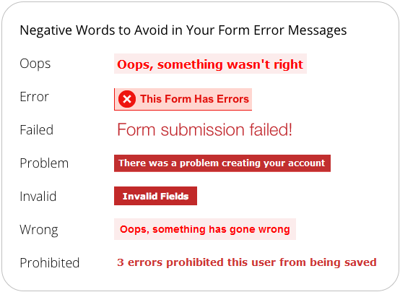

Slide 7
1. Error handling mechanism​ :
In Error Handling where in the errors are controlled, and some flow is executed when error occurs in the catches the error and do not report mule flow. If there is an error in the flow, then the subsequent flow will not get executed, and the error is thrown.
2. On Error continue :
It is an error, hence flow processing continue. It can be used when flow execution should not be distributed even after error is reported.
Comparing with java : logger. Error("error required");
3. On Error propagate :
How it process the error message and re-throws again to its parent flow once error re-throw, no further processing is done.
Comparing with java : error("error reported");
throw new exception();
​

Slide 8
4. Try Catch Scope :
It allows to do error handling for some specific components in that flow or within a flow. It also supports transactions. A try scope wraps one or more operations, then catches and handles any exceptions that might be thrown by any of these enclosed operations.
Comparing with java : try () catch () (specific exception e) ()

